Slide 1

TIME SERIES FORCASTING
CRUID OIL

Slide 2
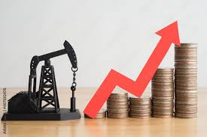
PROBLEM STATEMENT
The volatility of crude oil prices poses a significant challenge for effective resource planning and decision-making in the energy sector.
The objective of this project is to develop a robust time series forecasting model that accurately predicts future crude oil prices.
Enhance overall strategic planning in the dynamic and unpredictable crude oil market.

Slide 3

FEATURES OF DATASET
DATE : Date of every day in a year where the oil prices noticsed.
CLOSE/LAST : Price when the time of Closing or End up on particular Date.
VOLUME : Price of the oil which is maintained in lakhs in year wise.
OPEN : Opening price of the oil of particular day or Date.
HIGH : Highest price of the oil of particular day or date.
LOW : Lowest price of the oil of particular day or Date.

Slide 4

POINTS IMPLEMENTED
Problem Statement
Introduction
Data Cleaning
Exploratory Data Analysis
Tranforming the data
Splitting Data
Data Modelling
Model evaluation
Conclusion

Slide 5

EXPLORATORY DATA ANALYSIS
Null Values Treatment
Duplicated Values Treatment
Missing Values Treatment
Date Format Change
Outliers treatment
Correlation Analysis
Univariate Analysis
Bivariate Analysis

Slide 6
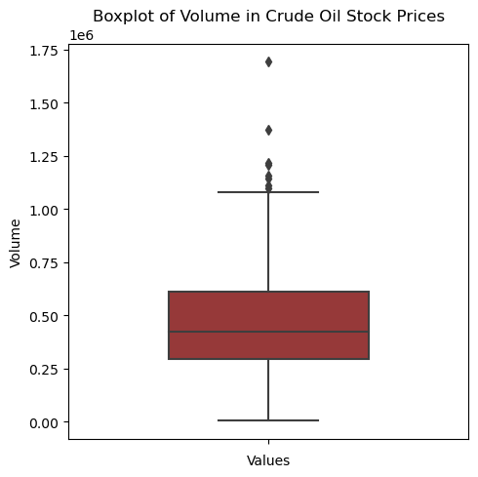
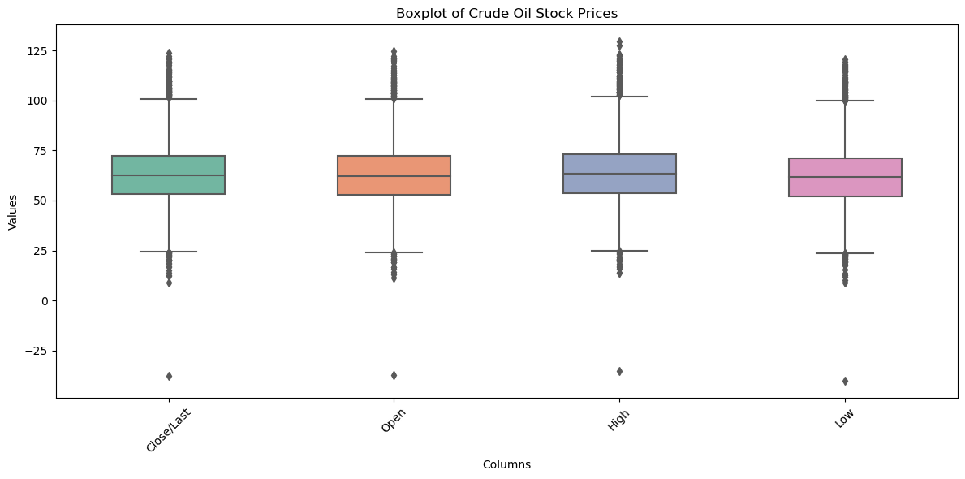
DETECTING OUTLIERS THROUGH BOXPLOTS
Outliers in Independent Columns
Outliers in Target Column

Slide 7
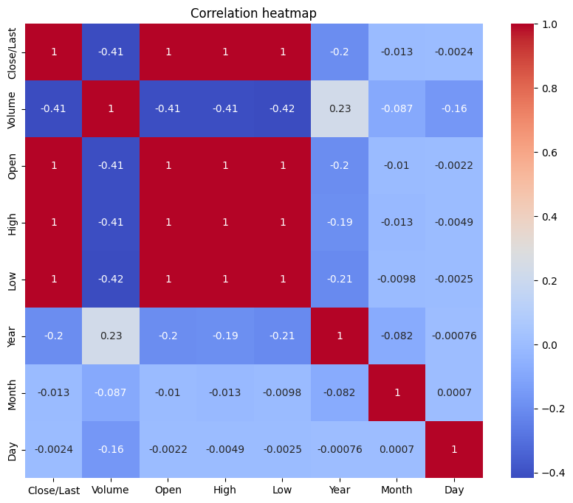
EXPLORATORY DATA ANALYSIS
Correlation HeatMap of the Dataset with Numerical values
Theres high correlation between the columns low, high, and close/last

Slide 8
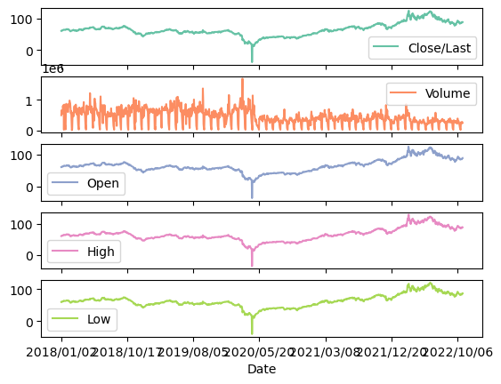
EXPLORATORY DATA ANALYSIS Visualizing the line plots for every feature in the dataset with making the relationship with the Target Column

Slide 9
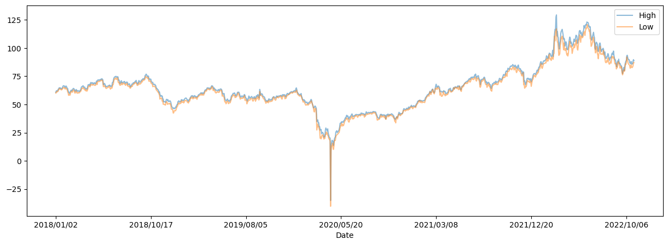
EXPLORATORY DATA ANALYSIS
Visualizing the Difference between the opening price and closing price

Slide 10
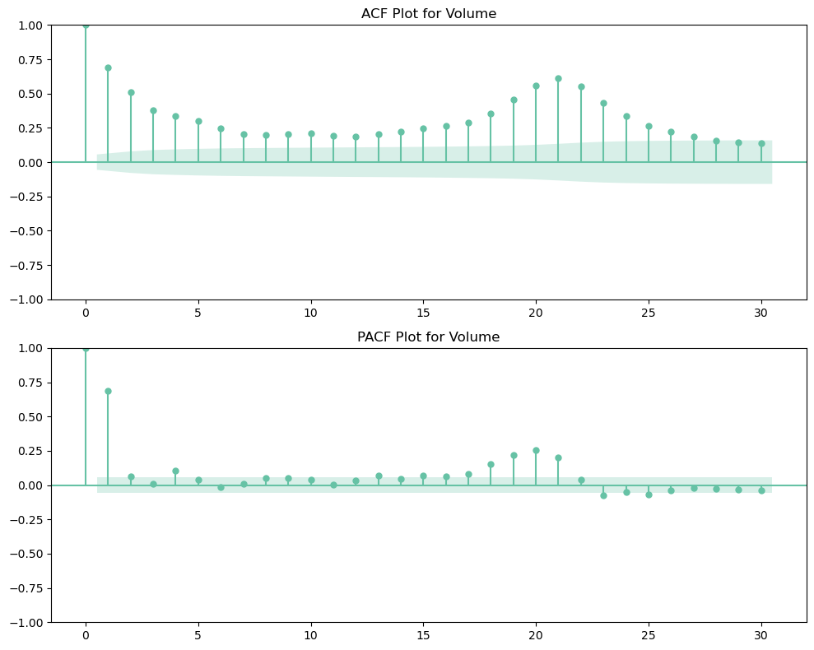
Realtion between ACF and PACF on Volume
Partial Autocorrelation function for Volume
The ACF plot shows constant pattern however the whole series does not show any trend. This give another justification to the fact that there is no seasonality in the series.
The ACF and PACF graphs also shows that the series is not stationary.
Autocorrelation function for Volume

Slide 11
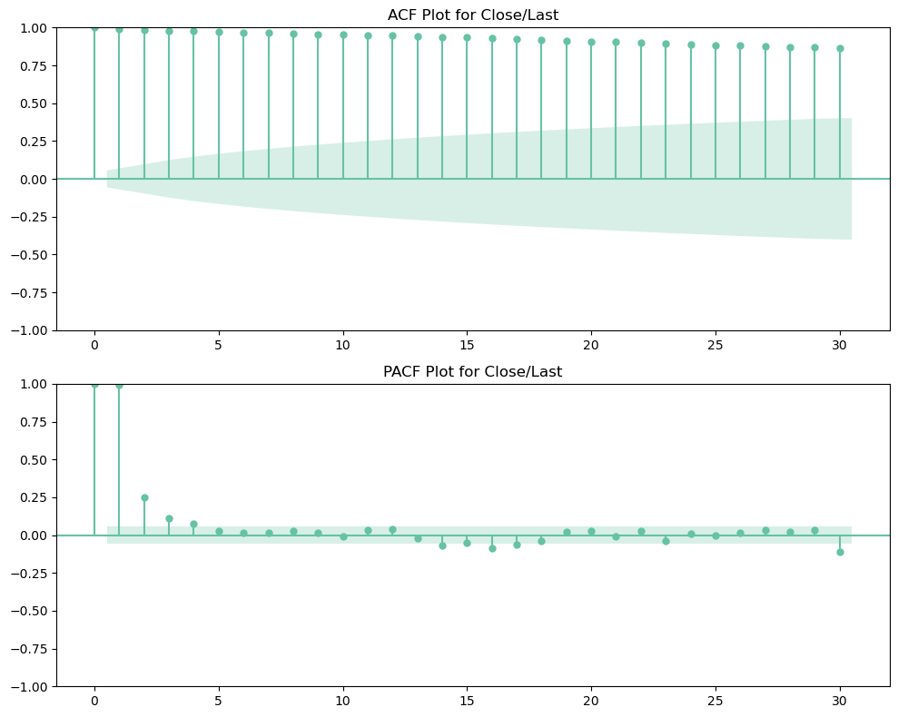
ACF AND PACF GRAPHS
The ACF and PACF of Close/Last price of the oil at a particular dates
The graphs shows different scenarios of the volume spreaded that pacf plot show well explanation about the exact price in density

Slide 12
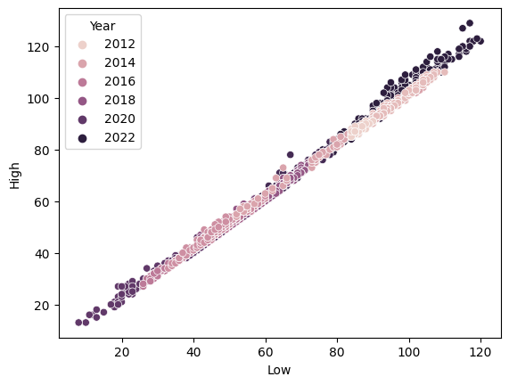
LOW AND HIGH PRICES
The graph shows us that the prices are at the low point and to high point are relative.
The prices of both increasing every year from 2012 – 2022
As we can notice that the price should constantly increases every year with low and high price

Slide 13
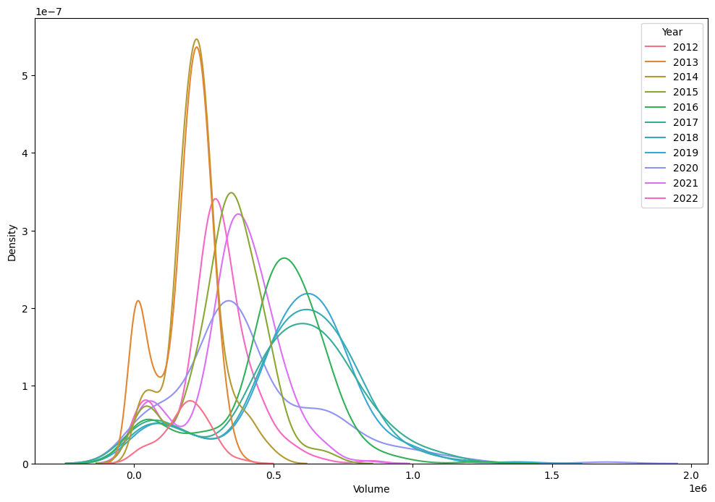
It is the line plot of volumes based on every year with elaborating of volume. Here we can see that the higher peek in the year of 2013 and 2014 has approximately constant volume and rest of the years are elaborated in increasing manner
Data visualization of KDE plot for every year of Volume generation

Slide 14
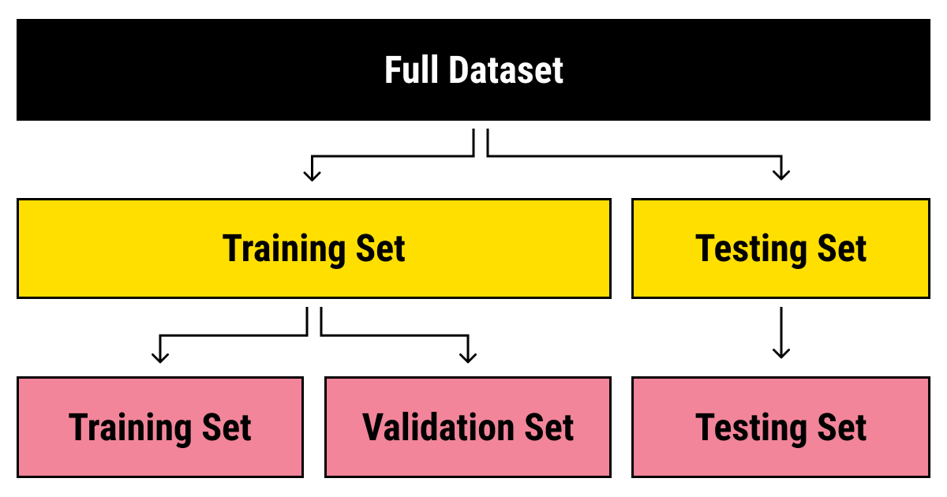
SPLITTING DATA
Data splits into training dataset and testing dataset.
Training dataset is for making algorithm learn and train model.
Test dataset is for testing the performance of train model.
Here 80% of data taken as training dataset & remaining 20% of dataset used for testing purpose.

Slide 15
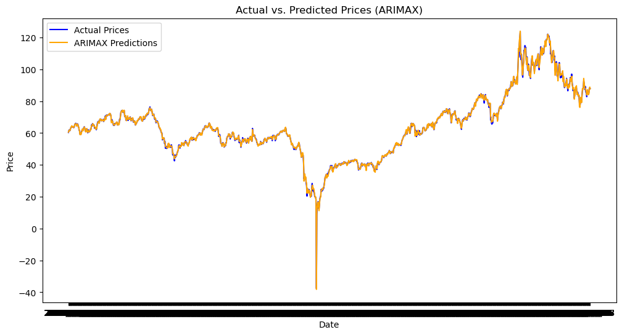
MODEL IMPLEMENTATION
ARIMAX
Model table with RMSE, MAE, and MAPE
ARIMAX:
RMSE=0.70,
MAE=0.49,
MAPE=0.81%,
Accuracy=96.49%

Slide 16
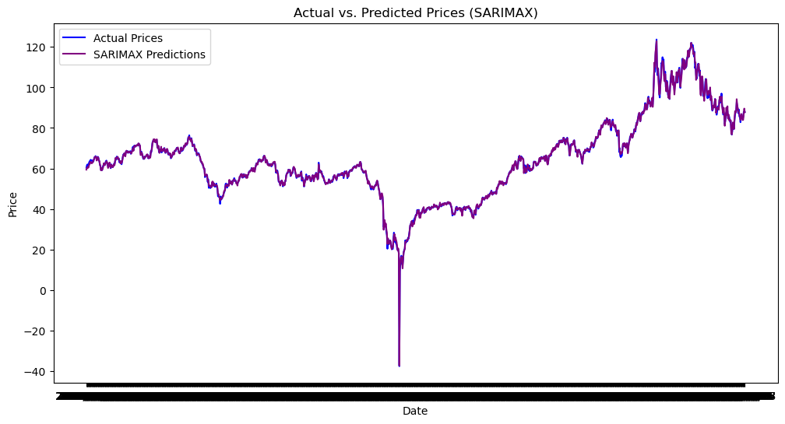
SARIMAX MODEL
It is a sophisticated time series forecasting model.
SARIMAX: RMSE=0.80, MAE=0.57, MAPE=0.96%, Accuracy=96.04%
Inclusion of exogenous variables enhances the model's ability to capture complex patterns and improve forecasting accuracy.

Slide 17
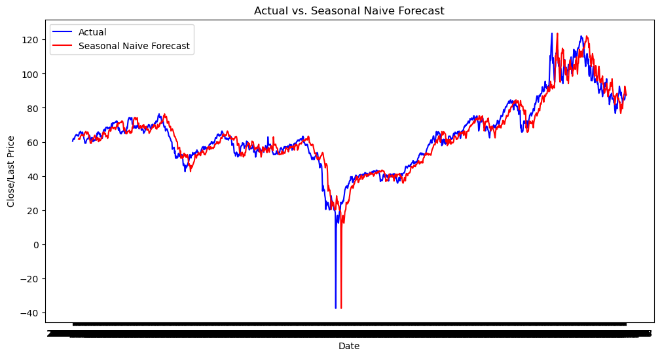
SEASONAL NAIVE
Seasonal Naïve :
RMSE=6.20,
MAE=4.30,
MAPE=8.08%
It relies solely on the most recent observation within the same season as the prediction point.
Offers quick insights without the computational complexity of more advanced forecasting techniques.

Slide 18
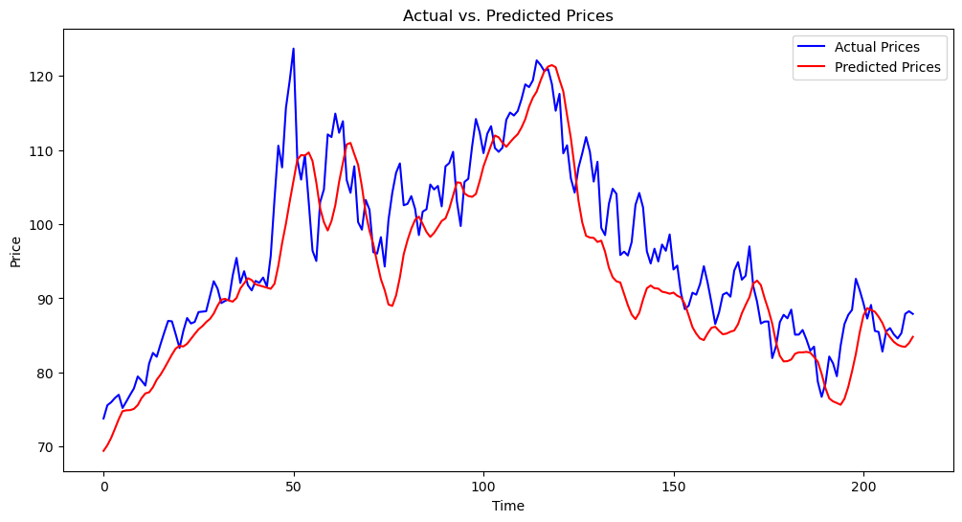
Long Short-Term Memory (LSTM)
METRICS :
RMSE:6.872
MAE:5.177
MAPE:5.243 Accuracy:0.60
Enabling the model to capture and remember long-term dependencies in sequential data
understand and retain context over extended periods is crucial for accurate predictions.

Slide 19
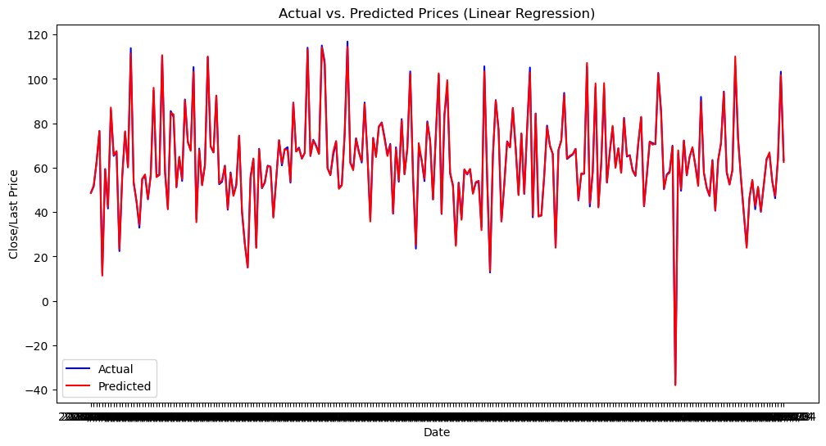
LINEAR REGRESSION
METRICS :
RMSE: 0.768
MAE: 0.508
MAPE: 0.868
Serves as a powerful tool for prediction and understanding the linear association between variables.
Providing insights into the strength and direction of the relationships.

Slide 20
Implemented the models includes ARIMAX SARIMAX, SEASONAL NAÏVE, LINEAR REGRESSION, LSTM.
Compared to all the ARIMAX Model performed well with Accuracy of 0.96

Slide 21
CONCLUSION
Model Evaluation: The success of our crude oil price prediction project lies in rigorous model evaluation, where we assessed the performance against historical data.
Accuracy Achievement: Our forecasting model demonstrated commendable accuracy, capturing the intricate patterns and fluctuations in crude oil prices.
Seasonal Trends: The incorporation of seasonal trends allowed the model to adapt to the cyclical nature of the crude oil market, enhancing its predictive capabilities.
Exogenous Factors: The consideration of external factors, such as geopolitical events and economic indicators, enriched the model's understanding, leading to more nuanced predictions.
Risk Mitigation: Accurate predictions empower stakeholders to proactively manage risks, providing a valuable tool for decision-making in the volatile energy sector.

Slide 22
6.Resource Optimization: With reliable forecasts, resource allocation and strategic planning can be optimized, contributing to operational efficiency and cost-effectiveness.
7.Adaptability: The model's adaptability to changing market dynamics positions it as a robust tool for real-time decision support, crucial in an ever-evolving industry.
8.Continuous Improvement: A commitment to ongoing refinement ensures that our forecasting model remains agile, adapting to new data and market trends for sustained accuracy.
9.Industry Impact: The insights gained from this project have the potential to significantly impact the energy industry, offering stakeholders a competitive edge through informed decision-making.
10.Future Prospects: As we conclude this project, the foundation laid for accurate crude oil price prediction opens doors for further research and advancements in forecasting methodologies, paving the way for a more resilient and proactive energy market.

Slide 23
THANK YOU

